Slide 1
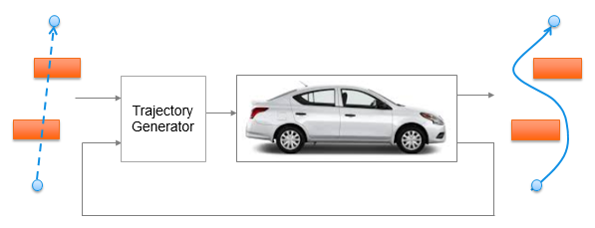
Trajectory Generation in High Density Environment
Mid-Term Review
Suvo Ganguli
Alberto Speranzon
Feb 2018

Slide 2
Overview
Trajectory Generation in 2-dimensional space
Laplacian Planner
Model Predictive Control (MPC)
Tradeoff Parameters
Tradeoff Data and Charts
Summary

Slide 3
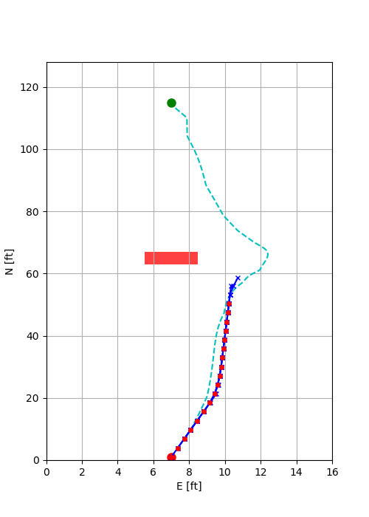
Trajectory Generation
There are two steps to the trajectory generation:
Laplacian Planner Trajectory Generation
Solves for a potential flow from start point to end point avoiding obstacles
Does not take into account vehicle dynamics and constraints
Provides an initial solution for the MPC Trajectory Generator
MPC Trajectory Generation
Solves an optimization problem to generate a short trajectory
Moves one step along the trajectory and resolves the optimization problem
Takes into account vehicle dynamics and constraints

Slide 4
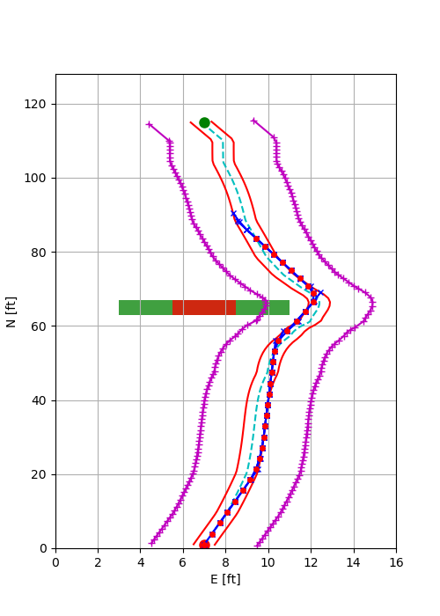
MPC Trajectory Generation
Minimize cost
Velocity error
Lateral path error
Control signals
Satisfy vehicle dynamics and constraints
Satisfy other constraints
Trajectory constraints
Terminal constraints
Lateral Acceleration constraint
Laplacian trajectory
Terminal constraints
Obstacle
Safety Margin
Trajectory constraints
MPC trajectory

Slide 5
Overview
Trajectory Generation in 2-dimensional space
Laplacian Planner
Model Predictive Control (MPC)
Tradeoff Parameters
Tradeoff Data and Charts
Summary

Slide 6
Tradeoff Parameters
Our goal is to trade off the CPU time (CT) with
Trajectory Parameters
Number of MPC time steps = N
MPC time step = T
Model Complexity
Number of states = ns
Obstacle density
Number of obstacles = no
Model Complexity
2 states model
4 state model
6 state model
Obstacle Density is measured by the number of obstacles which are
Static
Placed to obstruct the line of sight from the start point to the end point
CT
vs
N | T (sec) | ns | no
4 | 0.2 | 4 | 0
6 | 0.4 | 6 | 2
8 | 0.6 |  | 2
10

Slide 7
Model Complexity
4 state model
6 state model

Slide 8
Overview
Trajectory Generation in 2-dimensional space
Laplacian Planner
Model Predictive Control (MPC)
Tradeoff Parameters
Tradeoff Data and Charts
CPU time vs Number of Time Steps (CT vs N)
CPU time vs Number of Obstacles (CT vs no)
CPU time vs Number of States (CT vs ns)
Summary

Slide 9
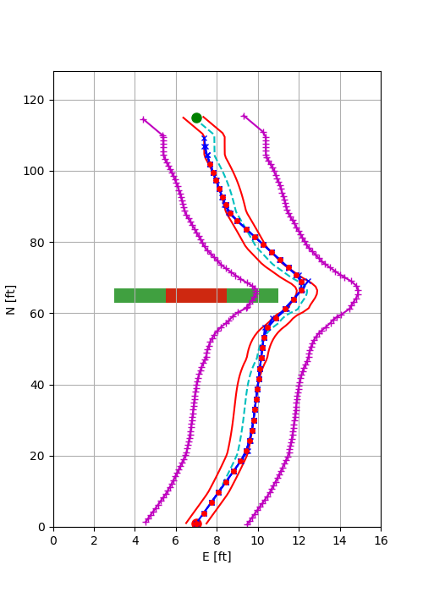
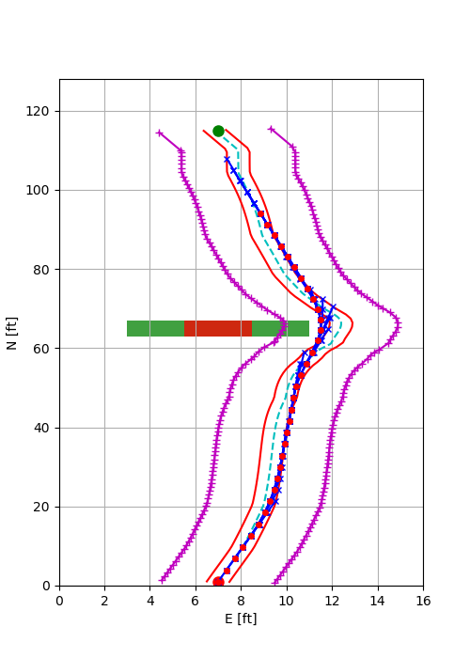
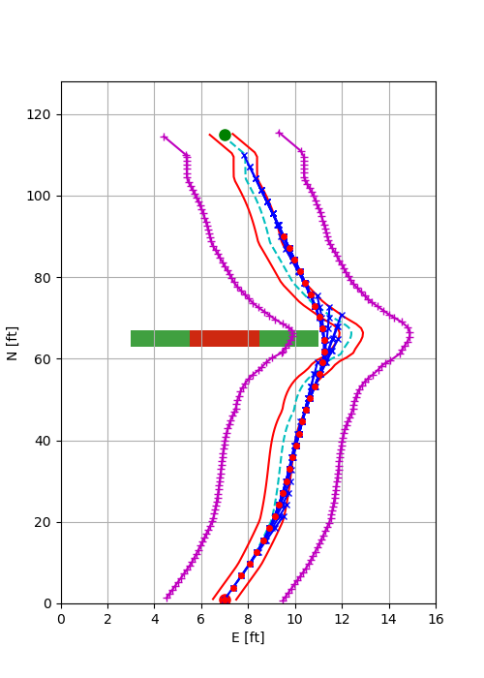
Trajectory Variation with No. of Time Steps
With number of states = 4 and number of obstacles = 1, as we increase the number of time steps = 4, 6, 8, we observe that the turn gets wider.
If a “ribbon” being pulled along a circuitous path, the longer the ribbon, the wider the turns.
N = 4
N = 6
N = 8

Slide 10
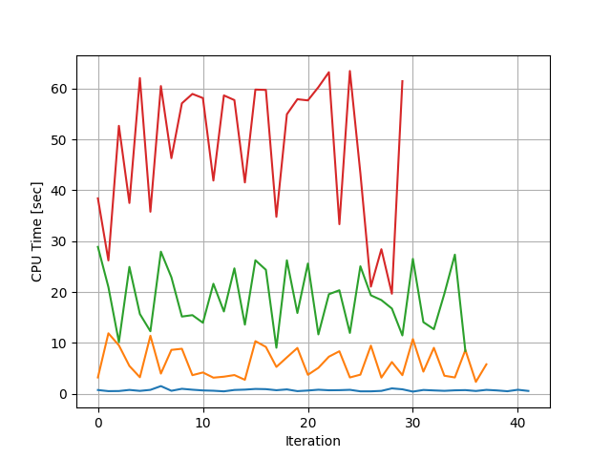
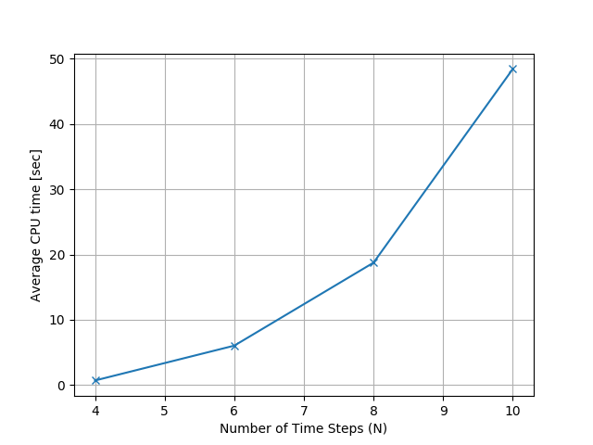
CPU Time vs No. of Time Steps (CT vs N)
CPU mean time increases with N as 2^{N}
N=10
N=8
N=6
N=4

Slide 11
Overview
Trajectory Generation in 2-dimensional space
Laplacian Planner
Model Predictive Control (MPC)
Tradeoff Parameters
Tradeoff Data and Charts
CPU time vs Number of Obstacles (CT vs N)
CPU time vs Number of Obstacles (CT vs no)
CPU time vs Number of Time Steps (CT vs ns)
Summary

Slide 12
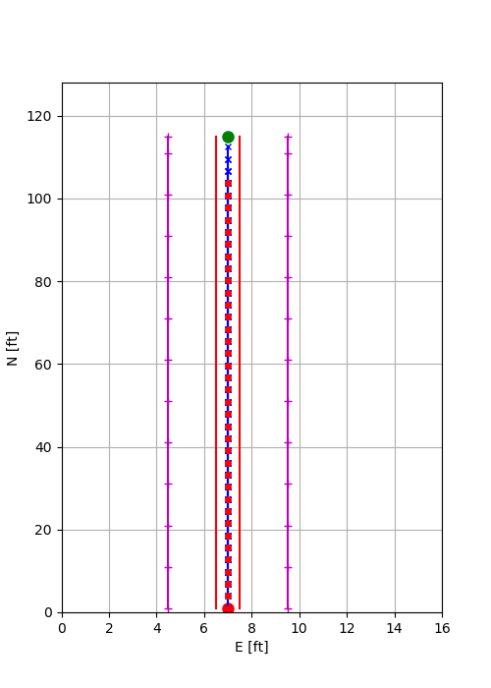
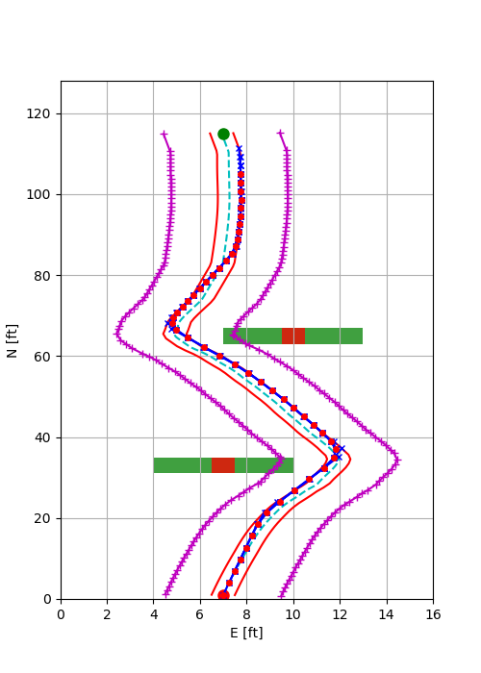
MPC Trajectory in Presence of Obstacles
MPC Trajectory Generator successfully generates path between the start and end point in presence of obstacles
N = 4, T = 0.4, ns = 4
No Obstacle
1 Obstacle
2 Obstacles

Slide 13
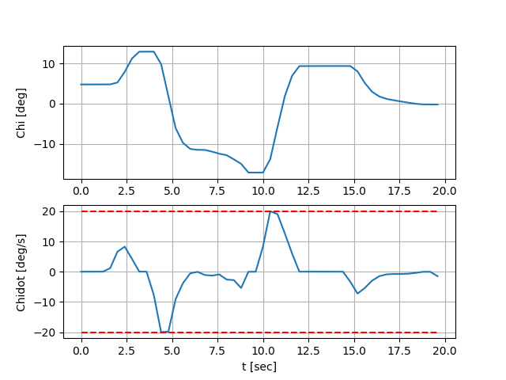
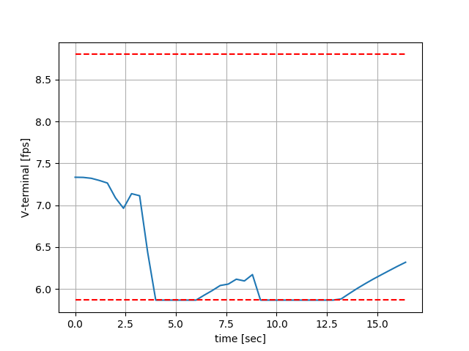
MPC Trajectory Satisfies Vehicle Constraints
N = 4, T = 0.4, ns = 4, no = 2
Corresponds to the turns to avoid the two obstacles

Slide 14
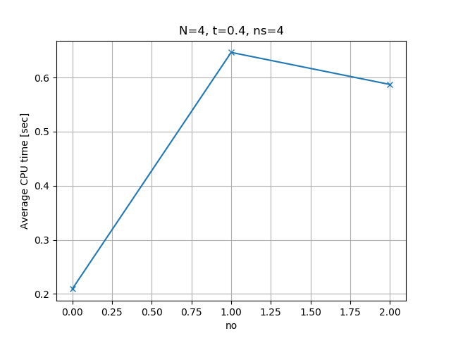
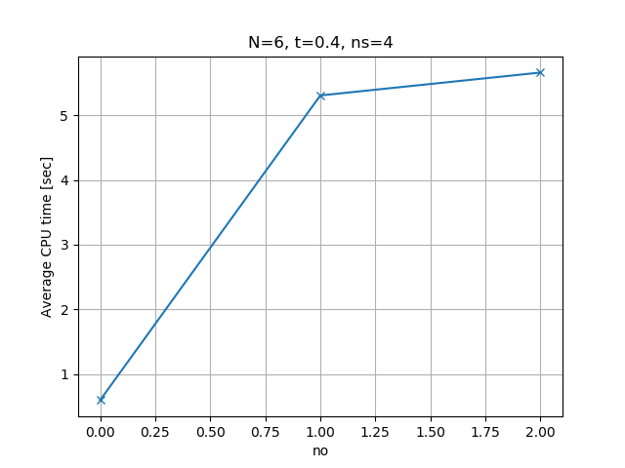
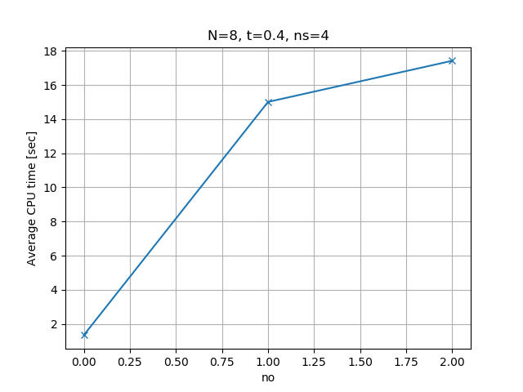
CPU Time vs Number of Obstacles (CT vs no)
Average CPU time increases (in general) with the number of obstacles
Average CPU time is increases with the number of MPC time steps
3x
9x
11x

Slide 15
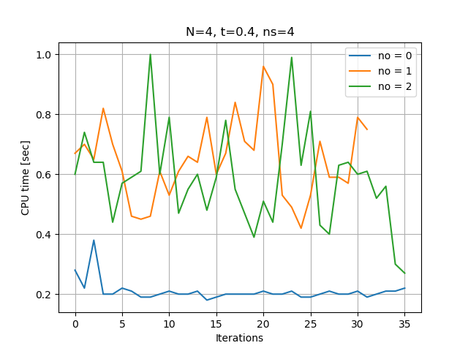
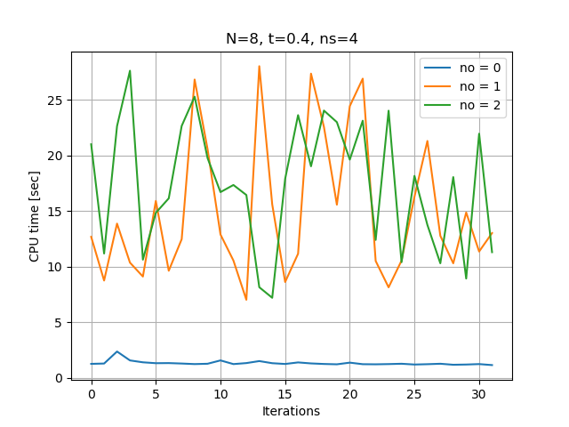
CPU Time vs Number of Obstacles (CT vs no)
CPU Time varies with the number of iterations. So, averaging over several runs will be more representative of CT vs no.
In case of N = 4, the trajectory generator hits less constraints once it passes the 2nd obstacle (due to the shorter horizon). This leads to slightly less average CT compared to the case with 1 obstacle.
constraints for final leg of trajectory is inactive for N=4

Slide 16
Overview
Trajectory Generation in 2-dimensional space
Laplacian Planner
Model Predictive Control (MPC)
Tradeoff Parameters
Tradeoff Data and Charts
CPU time vs Number of Time Steps (CT vs N)
CPU time vs Number of Obstacles (CT vs no)
CPU time vs Number of States (CT vs ns)
Summary

Slide 17
Overview
Trajectory Generation in 2-dimensional space
Laplacian Planner
Model Predictive Control (MPC)
Tradeoff Parameters
Tradeoff Data and Charts
CPU time vs Number of Obstacles (CT vs N)
CPU time vs Number of Obstacles (CT vs no)
CPU time vs Number of Time Steps (CT vs ns)
Summary

Slide 18
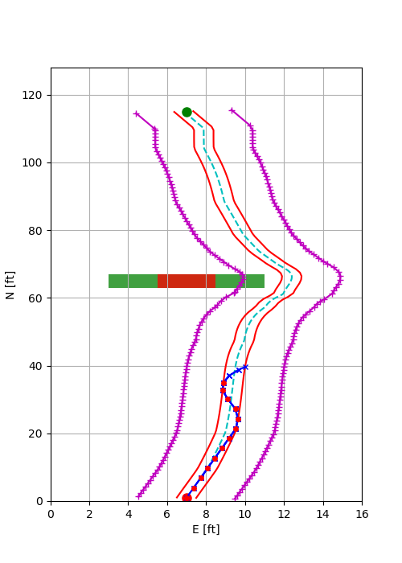
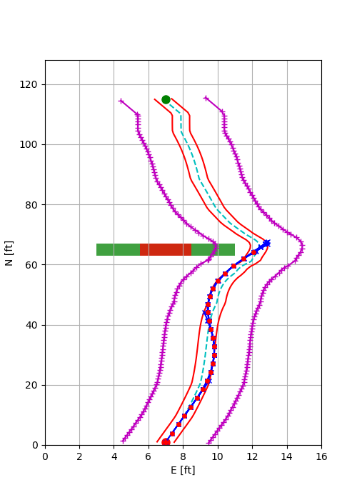
CPU Time vs Number of States (CT vs ns)
With number of time steps = 4, and number of states = 4, we get instability. This is due to relatively shorter horizon. Plus, the control is instead of which results in slower response.
With number of time steps = 4, and number of states = 6, the trajectory cannot negotiate the turn. This is due the relatively shorter horizon (N).
ns = 4
ns = 6

Slide 19
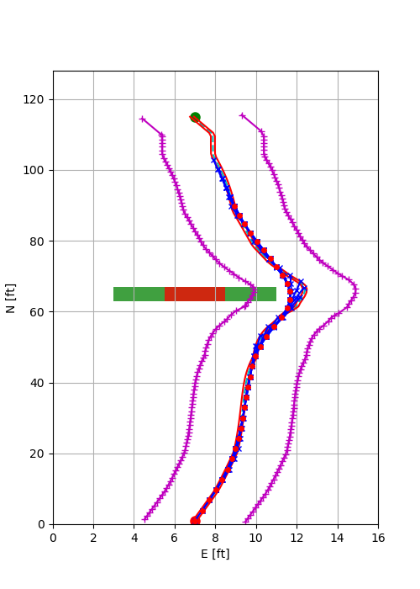
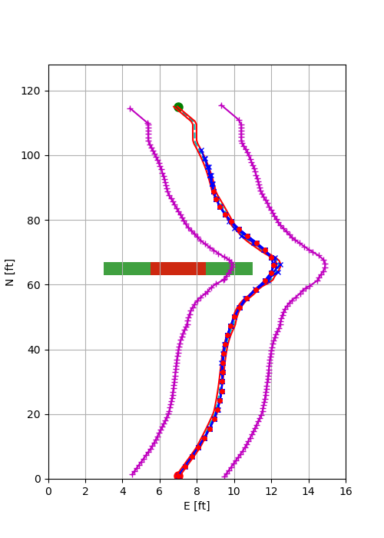
CPU Time vs Number of States (CT vs ns)
With number of time steps = 6, and number of states = 4 and 6, we can reach the end point when we make the following changes:
Reduce the lateral error margin for the terminal point
Add a terminal velocity constraint
ns = 4
ns = 6

Slide 20
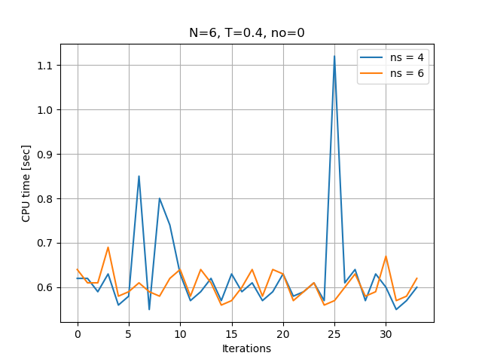
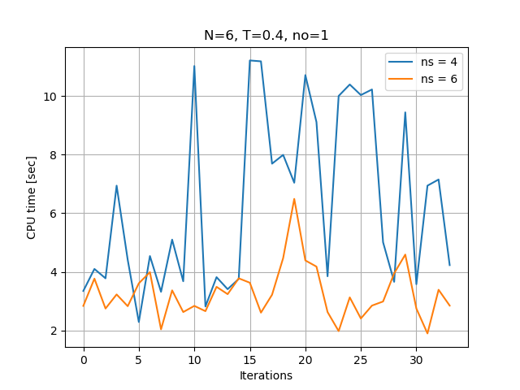
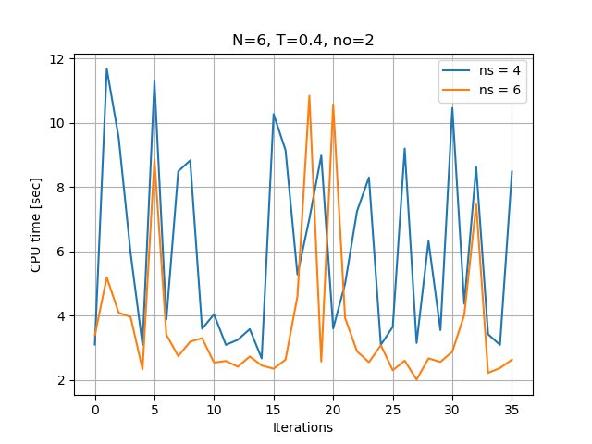
CPU Time vs Number of States (CT vs ns)
The CPU time is less for ns = 6 as compared to ns = 4. This is counter-intuitive and needs to be studied further.
Possible Explanation:
Number of active constraints are less for ns = 6
But that did not turn out to be correct (see next slide).
Number of variables = N.(ns + nu)
Number of constraints = 2N + 3
-- ns = 4, -- ns = 6
no = 0
no = 1
no = 2

Slide 21
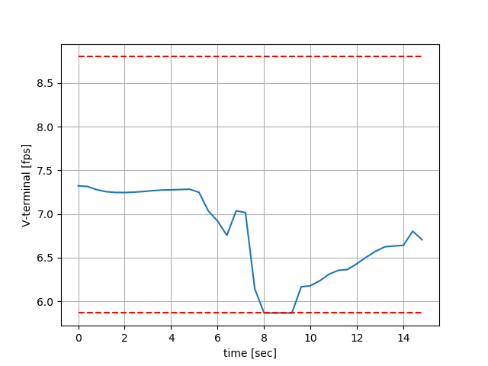
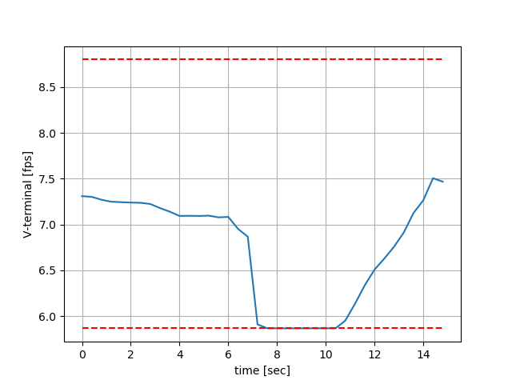
Constraints for 1 Obstacle
State and control constraints are not active in these cases
Path constraints are almost always active due to the narrow terminal constraint on lateral error for both ns = 4 and 6
Constraint on terminal velocity is active for slightly more time for ns = 6 than ns = 4. This does not explain why CT for ns = 6 is less than ns = 4
N = 6, T = 0.4, ns = 4
N = 6, T = 0.4, ns = 6
Terminal velocity constraint is active for longer time for ns = 6

Slide 22
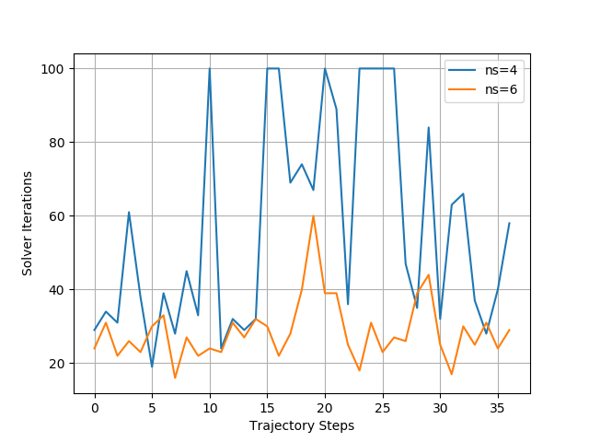
Number of Solver Iterations
Number of Solver Iterations for ns = 4 is much more than ns = 6. This explains why CT for ns = 6 takes less time than ns = 4
Possible explanation (needs to be checked):
Weight on Vdot control for ns = 4 is effectively less than Vddot for ns = 6

Slide 23
Summary
CPU Time (CT) increases with increase in number of obstacles (no) and number of time steps (N). This is expected.
CPU Time (CT) decreases with increase in number of states (ns). This is unexpected and needs to be studied further.

Slide 24
Pictures

Slide 25

Title Slide Picture
Trajectory Generator

